Slide 1
The meaning of human nature
Why only human beings can be ethical?
Prepared by: Eduardo S. Sucob, Jr.

Slide 2
The Meaning of Human Nature
Man is different from the rest of the animals in that he possesses the distinctive powers of reason and free will.
Man can see the sameness in difference, the oneness in many, the enduring reality behind outward change.
He knows meaning, law and purpose, and, through his power of free choice, he can choose between the various alternatives which are presented to him by his intellect.
Notes:
In short, man is a being altogether unique as compared with the rest of the physical universe, because in knowing and judging, he rises above the inexorable laws of matter.

Slide 3
The Meaning of Human Nature
Some philosophers and scientists insist on the strength and importance of man’s instincts and senses; and assert that man is deeply immersed within the forces of the physical universe.
Man is a material being, he is obedient to the laws of physical nature.
Man may be perceived as a material being or a being of with free will and intellect.
Notes:
Man is part of the animal kingdom.
Laws of physical nature – if man put his hand in fire, his hand will burn. If he goes out in the rain, he will get wet. If he doesn’t breathe or eat, he will die.
The systematic study of philosophy usually start with the problem of man himself and his destiny, then later proceed with the world in which man finds himself.

Slide 4
Four Experiences of the Human person
According to Michael Novak, there are four experiences of the human person that seem especially important in the quest for one’s own identity. These are the experiences of the activities of awareness, insight, reflective judgment, and the drive to understand. When man experiences these activities in his life and reflects on them, a man begins to understand how he is different from objects in the world.

Slide 5
Four Experiences of the Human person
1. Awareness – serves as the basic ground from which understanding appears to start. It is necessary for a human being to be conscious as an individual before he could dwell on questions and explore on answers. It is through one’s awareness that man is able to see through or reflect and to search for the meaning of his experiences and his life.

Slide 6
Four Experiences of the Human person
2. Insight – upon understanding of man and by his intelligence, he may find an emerging response to a certain stimulus; he sees the solution to his problem, discovers a way of relating the puzzling clues, finds the correct word for his crossword puzzle, gets the point of a joke. Insight is required for many tasks; plays many roles. It is often wordless and non-conceptual.

Slide 7
Four Experiences of the Human person
3. Reflective Judgment – Man is capable of arriving at a judgment based on evidence(s) that he has gathered that may support a certain idea or insight. This involves the individual, the conditions he set for the evidence, and the whys. Moreover, the knower will assure himself that he is in the position to know what he has acquired and is adequate to the task as he makes his reflective judgment on matters that may concern his life and his existence.

Slide 8
Four Experiences of the Human person
4. The Drive to Understand – Man is driven by his thirst to know the truth about him and sometimes wishes to understand exactly how things are in themselves.* Through his drive to understand, a man is capable of discounting some of his limitations and interests for the sake of explanatory understanding. The drive to understand has three characteristics, namely: unstructured, unlimited and objective.**
Notes:
* Man is sometimes interested in understanding how things are related to his sense perception, interests, viewpoints, and needs. He is also interested in how things are related to one another, apart from their relation to him.
** unstructured – man can use a variety of procedures or methods of inquiry
unlimited – man cannot be stopped from knowing and understanding the things around him and sometimes he goes beyond his senses and tries to push his limits
objective – its goal is the real and not the imagined.

Slide 9
Culture
Meaning and Its Influence on Moral Development

Slide 10
Culture, Defined:
It refers to that complex whole which includes knowledge, belief, art, law, morals, custom, and any other capabilities and habits acquired by man as a member of society- Edward Tylor
It refers to an appreciation of good literature, music, art, and food.

Slide 11
Culture, Defined:
For anthropologists and other behavioral scientists, culture is the full range of learned human behavior patterns.
Culture is a powerful human tool for survival, but it is a fragile phenomenon.
It is constantly changing and easily lost because it exists only in our minds.

Slide 12
Features and Characteristics of Culture
Learned | Social
Shared | Transmitted
Accumulative | Continuous
Integrated | Changing
Responsive | Gratifying
Linked with other society

Slide 13
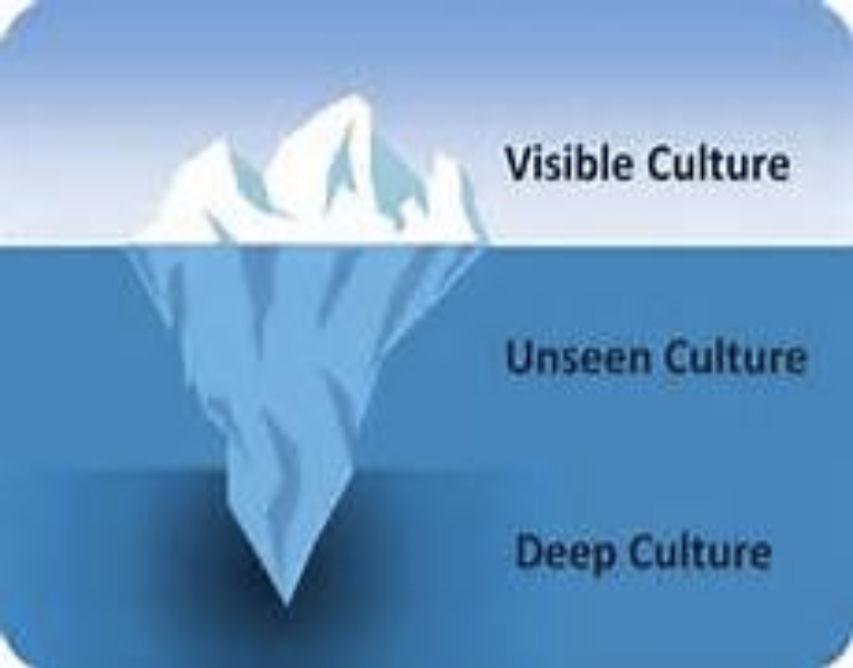
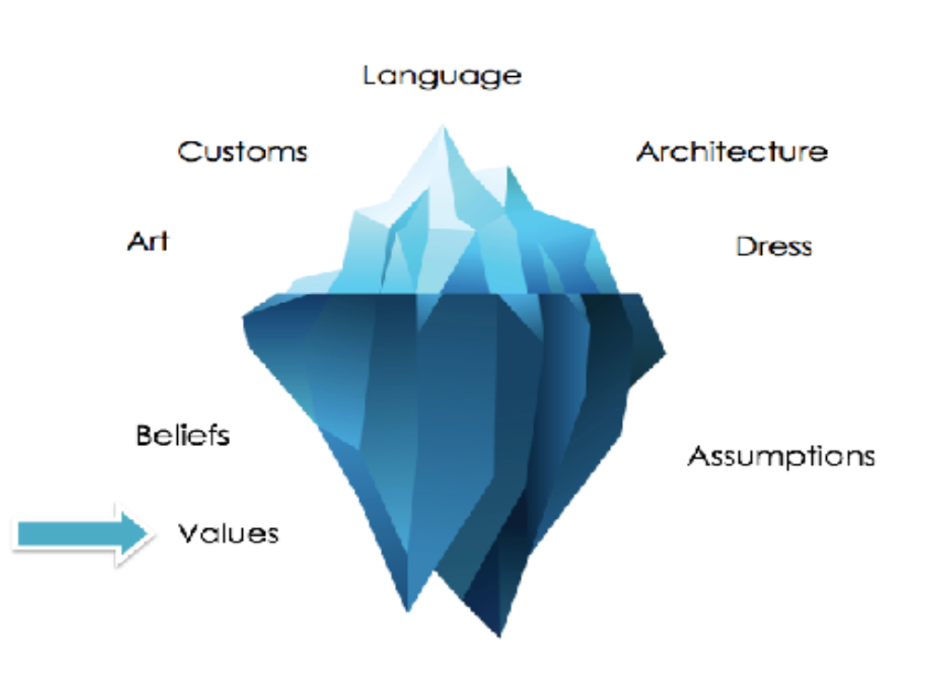
CORE LAYERS OF CULTURE

Slide 14
Layers of Culture by Dennis O’Neil
First Layer – the body of cultural traditions that distinguish a specific society. Example: When people speak of Italian, Samoan, or Japanese culture, they are referring to the shared language, traditions, and beliefs that set each of these peoples apart from others.
Example:
We Filipinos can eat with our bare hands.
The use of ‘po’ and ‘opo’.
The harana in courtship.

Slide 15
Layers of Culture by Dennis O’Neil
Second Layer – culture that may be part of an identity is the subculture. This occurs in a complex, diverse societies in which people have come from many different parts of the world, they often retain much of their original cultural traditions.
As the cultural differences between members of a subculture and the dominant national culture blur and eventually disappear, the subculture ceases to exist except as a group of people who claim a common ancestry.
  Example: The diverse languages in the regions (Tagalog, Visaya, Kapampangan, et. ) of the Philippines. In the end we are still Filipinos.

Slide 16
Layers of Culture by Dennis O’Neil
Third Layer - consists of cultural universals. These are learned behavior patterns that are shared by all of humanity collectively. No matter where people live in the world, they share these universal traits.
Example: As human beings we believe in the concept of virtues, justice, love, etc.

Slide 17
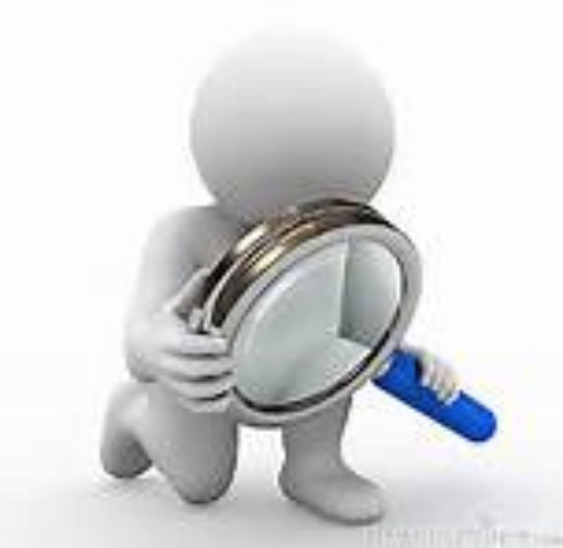
FILIPINO’S VIEWS ON ETHICS
• Propriety (Hiya) versus Troubled (Pagkabagabag)
• Personal versus Duty/Obligations
• Family solidarity versus universal principle and general good
• Pakikipag kapwa tao versus Pakikisama

Slide 18
THE FILIPINO CHARACTER
Strengths | Weaknesses
Pakikipag kapwa tao | Extreme personalism
Family solidarity | Extreme family centeredness
Joy and humor | Lack of discipline
Flexibility, adaptability, and creativity | Passivity and lack of initiative
Hard work and industry | Colonial Mentality
Hospitality | Lavishness, outright display of generosity
Gender Specific Values | Stereotyping; role-gender assignment
Faith and religiosity | Kanya kanya syndrome
Ability to survive | Lack of self-analysis and self-reflection

Slide 19
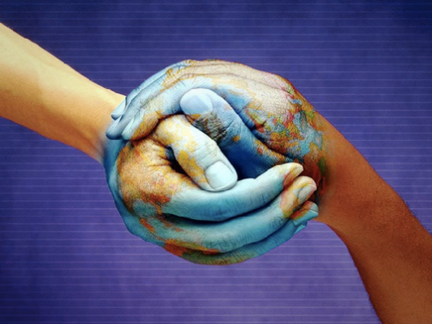
ASIANS VS WESTERNERS
Asians | Westerners
Collectivistic (community and family) | Individualistic
Risk avoidance | Risk taker (Willing to take risk)
Asian men do not compete directly against women, and vice-versa | Gender free competition
Attitude: Holistic views | Attitude: Analytical and detailed
Suppress one’s opinions | Expresses one’s opinions freely
Time orientation: Cynical | Time orientation: Linear

